Slide 1

Finding Similar Items: Locality Sensitive Hashing
Note to other teachers and users of these slides: We would be delighted if you found this our material useful in giving your own lectures. Feel free to use these slides verbatim, or to modify them to fit your own needs. If you make use of a significant portion of these slides in your own lecture, please include this message, or a link to our web site: http://www.mmds.org
Mining of Massive Datasets
Jure Leskovec, Anand Rajaraman, Jeff Ullman Stanford University
http://www.mmds.org

Slide 2
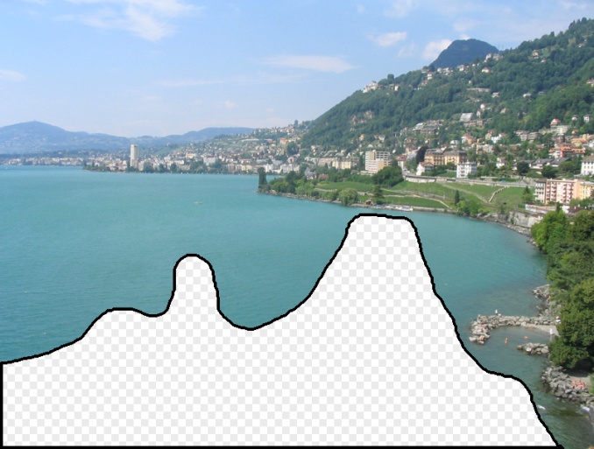

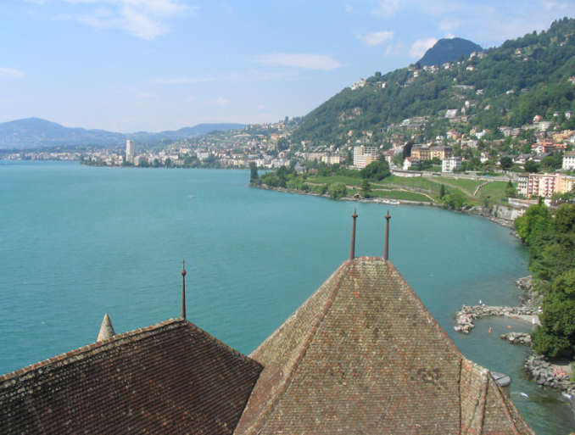
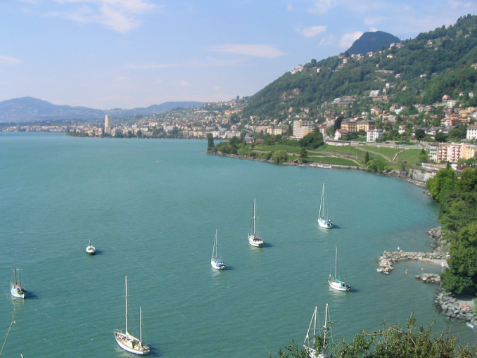
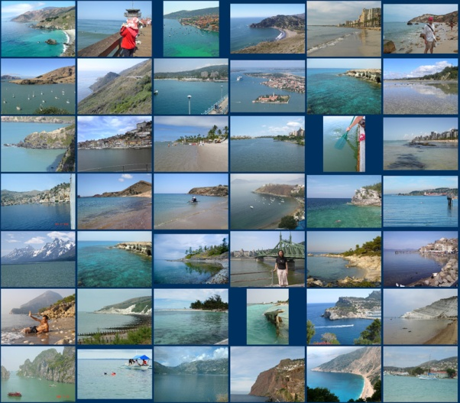
Scene Completion Problem
[Hays and Efros, SIGGRAPH 2007]

Slide 3

Scene Completion Problem
[Hays and Efros, SIGGRAPH 2007]
Notes:
10 nearest neighbors, 20,000 image database

Slide 4

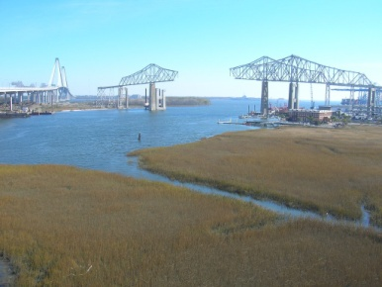

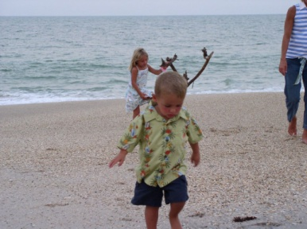
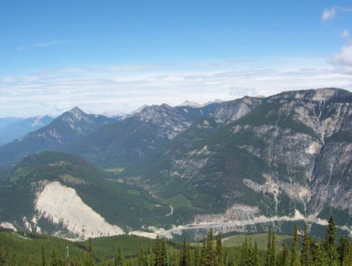
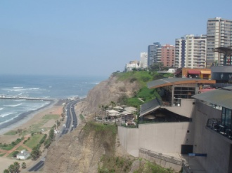
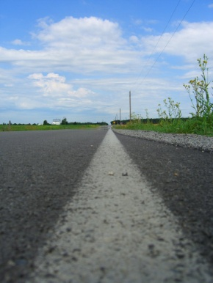
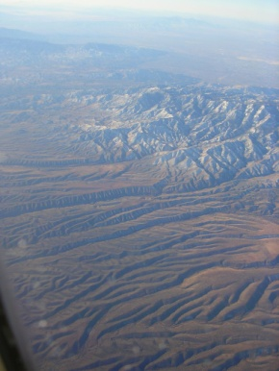
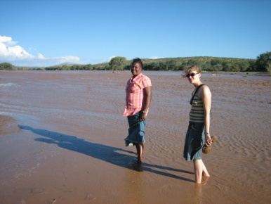

Scene Completion Problem
[Hays and Efros, SIGGRAPH 2007]
10 nearest neighbors from a collection of 20,000 images
Notes:
10 nearest neighbors, 20,000 image database

Slide 5
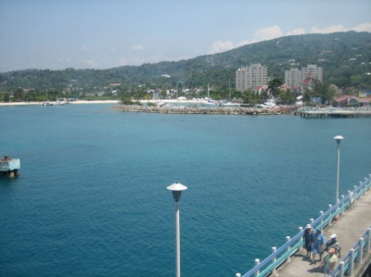
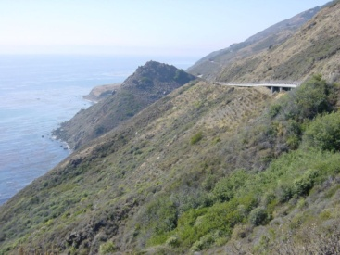
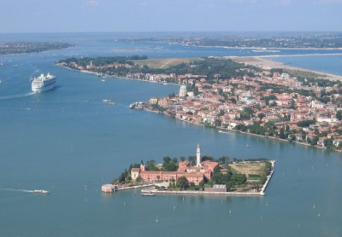
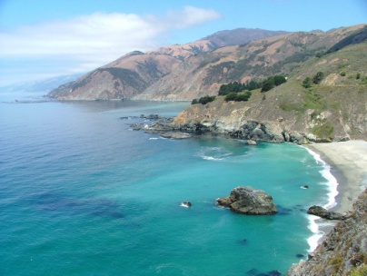

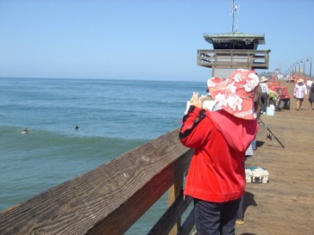
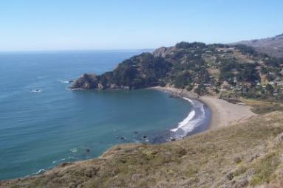
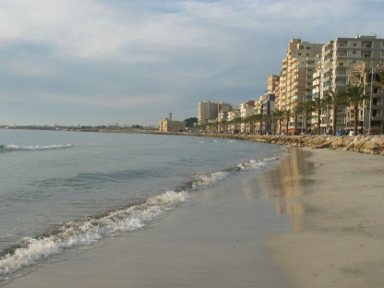

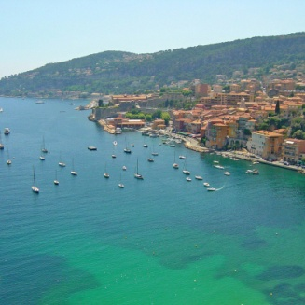
Scene Completion Problem
[Hays and Efros, SIGGRAPH 2007]
10 nearest neighbors from a collection of 2 million images
Notes:
10 nearest neighbors, 2.3 million image database

Slide 6
A Common Metaphor
Many problems can be expressed as finding “similar” sets:
Find near-neighbors in high-dimensional space
Examples:
Pages with similar words
For duplicate detection, classification by topic
Customers who purchased similar products
Products with similar customer sets
Images with similar features
Users who visited similar websites

Slide 7
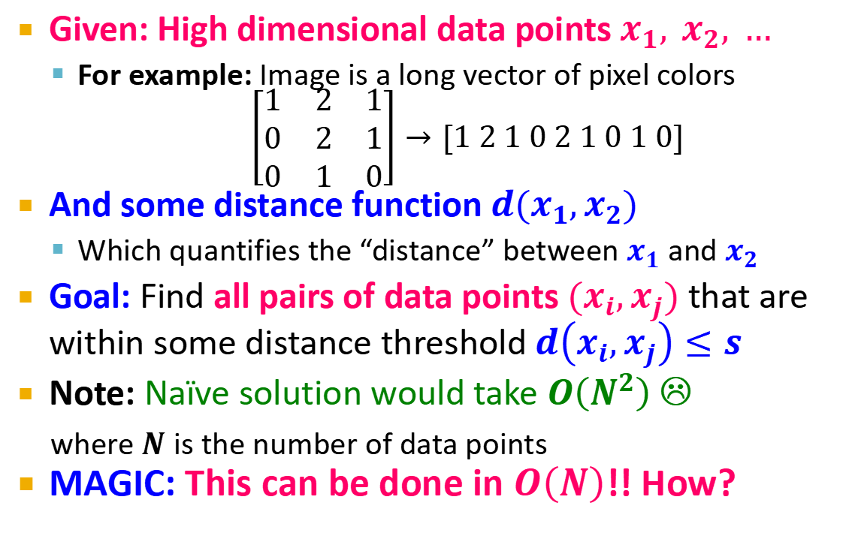
Problem for Today’s Lecture
Given: High dimensional data points $x_{1}, x_{2}, …$
For example: Image is a long vector of pixel colors
$$\left[\begin{matrix}1 & 2 & 1 \\ 0 & 2 & 1 \\ 0 & 1 & 0\end{matrix}\right]→[1 2 1 0 2 1 0 1 0]$$
And some distance function $d(x_{1},x_{2})$
Which quantifies the “distance” between $x_{1}$ and $x_{2}$
Goal: Find all pairs of data points $(x_{i},x_{j})$ that are within some distance threshold $d\left(x_{i},x_{j}\right)≤s$
Note: Naïve solution would take $O\left(N^{2}\right)$ ☹
where $N$ is the number of data points
MAGIC: This can be done in $O\left(N\right)$!! How?

Slide 8
Distance Measures
Goal: Find near-neighbors in high-dim. space
We formally define “near neighbors” as points that are a “small distance” apart
For each application, we first need to define what “distance” means
Today: Jaccard distance/similarity
The Jaccard similarity of two sets is the size of their intersection divided by the size of their union: sim(C₁, C₂) = |C₁∩C₂|/|C₁∪C₂|
Jaccard distance: d(C₁, C₂) = 1 - |C₁∩C₂|/|C₁∪C₂|
3 in intersection
8 in union
Jaccard similarity= 3/8
Jaccard distance = 5/8

Slide 9
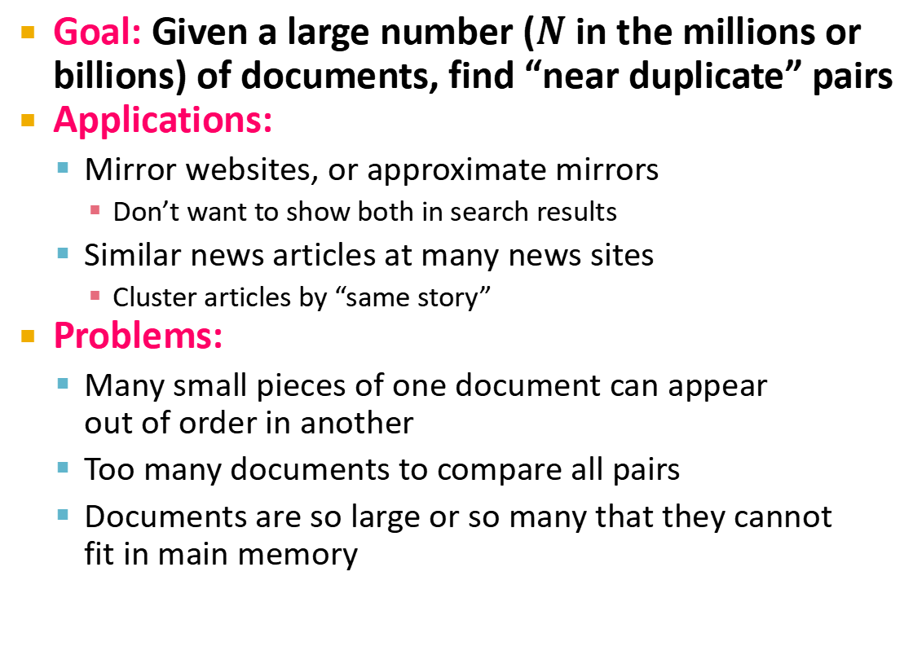
Task: Finding Similar Documents
Goal: Given a large number ($N$ in the millions or billions) of documents, find “near duplicate” pairs
Applications:
Mirror websites, or approximate mirrors
Don’t want to show both in search results
Similar news articles at many news sites
Cluster articles by “same story”
Problems:
Many small pieces of one document can appear out of order in another
Too many documents to compare all pairs
Documents are so large or so many that they cannot fit in main memory

Slide 10
3 Essential Steps for Similar Docs
Shingling: Convert documents to sets
Min-Hashing: Convert large sets to short signatures, while preserving similarity
Locality-Sensitive Hashing: Focus on pairs of signatures likely to be from similar documents
Candidate pairs!

Slide 11
The Big Picture
Candidate
pairs:
those pairs
of signatures
that we need
to test for
similarity
Shingling
Min Hashing
Locality-
Sensitive
Hashing
Docu-
ment
The set
of strings
of length k
that appear
in the doc-
ument
Signatures:
short integer
vectors that
represent the
sets, and
reflect their
similarity

Slide 12
Shingling
Shingling
Docu-
ment
The set
of strings
of length k
that appear
in the doc-
ument
Step 1: Shingling: Convert documents to sets

Slide 13
Documents as High-Dim Data
Step 1: Shingling: Convert documents to sets
Simple approaches:
Document = set of words appearing in document
Document = set of “important” words
Don’t work well for this application. Why?
Need to account for ordering of words!
A different way: Shingles!

Slide 14
Define: Shingles
A k-shingle (or k-gram) for a document is a sequence of k tokens that appears in the doc
Tokens can be characters, words or something else, depending on the application
Assume tokens = characters for examples
Example: k=2; document D₁ = abcab Set of 2-shingles: S(D₁) = {ab, bc, ca}
Option: Shingles as a bag (multiset), count ab twice: S’(D₁) = {ab, bc, ca, ab}

Slide 15
Compressing Shingles
To compress long shingles, we can hash them to (say) 4 bytes
Represent a document by the set of hash values of its k-shingles
Idea: Two documents could (rarely) appear to have shingles in common, when in fact only the hash-values were shared
Example: k=2; document D₁= abcab Set of 2-shingles: S(D₁) = {ab, bc, ca} Hash the singles: h(D₁) = {1, 5, 7}

Slide 16
Similarity Metric for Shingles
Document D₁ is a set of its k-shingles C₁=S(D₁)
Equivalently, each document is a 0/1 vector in the space of k-shingles
Each unique shingle is a dimension
Vectors are very sparse
A natural similarity measure is the Jaccard similarity:
sim(D₁, D₂) = |C₁∩C₂|/|C₁∪C₂|

Slide 17
Working Assumption
Documents that have lots of shingles in common have similar text, even if the text appears in different order
Caveat: You must pick k large enough, or most documents will have most shingles
k = 5 is OK for short documents
k = 10 is better for long documents

Slide 18
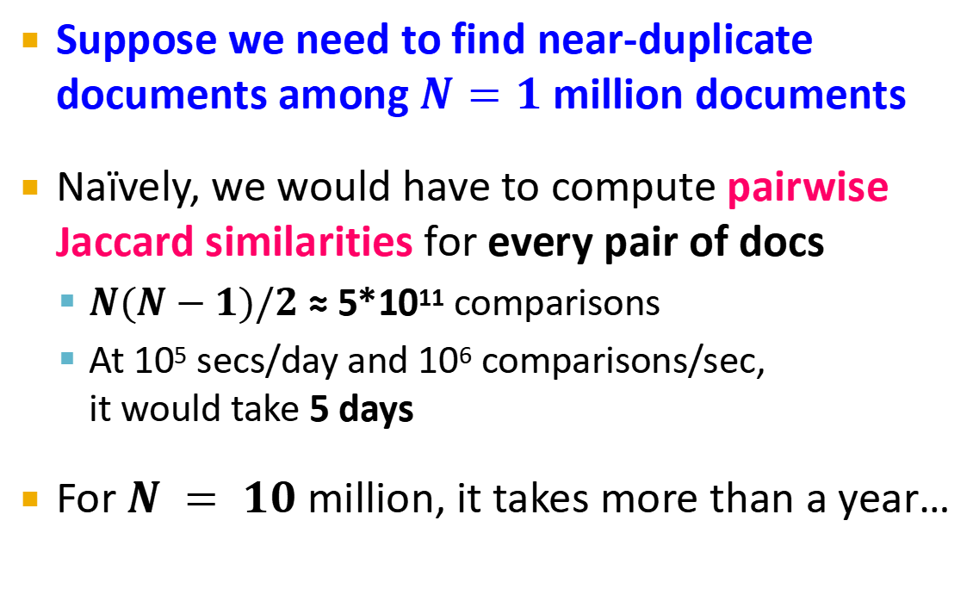
Motivation for Minhash/LSH
Suppose we need to find near-duplicate documents among $N=1$ million documents
Naïvely, we would have to compute pairwise Jaccard similarities for every pair of docs
$N(N−1)/2$ ≈ 5*10¹¹ comparisons
At 10⁵ secs/day and 10⁶ comparisons/sec, it would take 5 days
For $N = 10$ million, it takes more than a year…

Slide 19
MinHashing
Shingling
Min-Hash-
ing
Docu-
ment
The set
of strings
of length k
that appear
in the doc-
ument
Signatures:
short integer
vectors that
represent the
sets, and
reflect their
similarity
Step 2: Minhashing: Convert large sets to short signatures, while preserving similarity

Slide 20
Encoding Sets as Bit Vectors
Many similarity problems can be formalized as finding subsets that have significant intersection
Encode sets using 0/1 (bit, boolean) vectors
One dimension per element in the universal set
Interpret set intersection as bitwise AND, and set union as bitwise OR
Example: C₁ = 10111; C₂ = 10011
Size of intersection = 3; size of union = 4,
Jaccard similarity (not distance) = 3/4
Distance: d(C₁,C₂) = 1 – (Jaccard similarity) = 1/4

Slide 21
From Sets to Boolean Matrices
Rows = elements (shingles)
Columns = sets (documents)
1 in row e and column s if and only if e is a member of s
Column similarity is the Jaccard similarity of the corresponding sets (rows with value 1)
Typical matrix is sparse!
Each document is a column:
Example: sim(C₁ ,C₂) = ?
Size of intersection = 3; size of union = 6, Jaccard similarity (not distance) = 3/6
d(C₁,C₂) = 1 – (Jaccard similarity) = 3/6
Documents
1
1
1
0
1
1
0
1
0
1
0
1
0
0
0
1
Shingles
1
0
0
1
1
1
1
0
1
0
1
0

Slide 22
Outline: Finding Similar Columns
So far:
Documents → Sets of shingles
Represent sets as boolean vectors in a matrix
Next goal: Find similar columns while computing small signatures
Similarity of columns == similarity of signatures

Slide 23
Outline: Finding Similar Columns
Next Goal: Find similar columns, Small signatures
Naïve approach:
1) Signatures of columns: small summaries of columns
2) Examine pairs of signatures to find similar columns
Essential: Similarities of signatures and columns are related
3) Optional: Check that columns with similar signatures are really similar
Warnings:
Comparing all pairs may take too much time: Job for LSH
These methods can produce false negatives, and even false positives (if the optional check is not made)

Slide 24
Hashing Columns (Signatures)
Key idea: “hash” each column C to a small signature h(C), such that:
(1) h(C) is small enough that the signature fits in RAM
(2) sim(C₁, C₂) is the same as the “similarity” of signatures h(C₁) and h(C₂)
Goal: Find a hash function h(·) such that:
If sim(C₁,C₂) is high, then with high prob. h(C₁) = h(C₂)
If sim(C₁,C₂) is low, then with high prob. h(C₁) ≠ h(C₂)
Hash docs into buckets. Expect that “most” pairs of near duplicate docs hash into the same bucket!

Slide 25
Min-Hashing
Goal: Find a hash function h(·) such that:
if sim(C₁,C₂) is high, then with high prob. h(C₁) = h(C₂)
if sim(C₁,C₂) is low, then with high prob. h(C₁) ≠ h(C₂)
Clearly, the hash function depends on the similarity metric:
Not all similarity metrics have a suitable hash function
There is a suitable hash function for the Jaccard similarity: It is called Min-Hashing

Slide 26
Min-Hashing
Imagine the rows of the boolean matrix permuted under random permutation π
Define a “hash” function h_{π}(C) = the index of the first (in the permuted order π) row in which column C has value 1:
h_{π} (C) = min_{π} π(C)
Use several (e.g., 100) independent hash functions (that is, permutations) to create a signature of a column

Slide 27
Min-Hashing Example
Note: Another (equivalent) way is to store row indexes:
1 | 5 | 1 | 5
2 | 3 | 1 | 3
6 | 4 | 6 | 4
2nd element of the permutation is the first to map to a 1
Permutation π
Input matrix (Shingles x Documents)
Signature matrix M
2
4
3
4
7
2
6
1
5
1
0
1
0
2
1
2
1
3
2
1
0
0
1
2
1
4
1
7
1
0
1
0
1
1
2
1
2
6
3
0
1
0
1
1
6
0
1
0
1
4th element of the permutation is the first to map to a 1
5
7
1
0
1
0
4
5
1
0
1
0

Slide 28
The Min-Hash Property
0
0
0
0
1
1
Choose a random permutation π
Claim: Pr[h_{π}(C₁) = h_{π}(C₂)] = sim(C₁, C₂)
Why?
Let X be a doc (set of shingles), y∈ X is a shingle
Then: Pr[π(y) = min(π(X))] = 1/|X|
It is equally likely that any y∈ X is mapped to the min element
Let y be s.t. π(y) = min(π(C₁∪C₂))
Then either: π(y) = min(π(C₁)) if y ∈ C₁ , or
π(y) = min(π(C₂)) if y ∈ C₂
So the prob. that both are true is the prob. y ∈ C₁ ∩ C₂
Pr[min(π(C₁))=min(π(C₂))]=|C₁∩C₂|/|C₁∪C₂|= sim(C₁, C₂)
0
0
0
1
1
0
One of the two cols had to have 1 at position y
Notes:
Size of the universe of all possible vals of min(π(C₁∪C₂)) is |C₁∪C₂| and in |C₁∩C₂| of cases it can be that min(π(C₁))=min(π(C₂)) which exactly the jaccard between C1 and C2
For two columns A and B, we have h_π(A) = h_π(B) exactly when the minimum hash value of the union A ∪ B lies in the intersection A ∩ B. Thus Pr[h_π(A) = h_π(B)] = |A ∩ B| / |A ∪ B|.

Slide 29
Four Types of Rows
Given cols C₁ and C₂, rows may be classified as:
C₁ C₂
A 1 1
B 1 0
C 0 1
D 0 0
a = # rows of type A, etc.
Note: sim(C₁, C₂) = a/(a +b +c)
Then: Pr[h(C₁) = h(C₂)] = Sim(C₁, C₂)
Look down the cols C₁ and C₂ until we see a 1
If it’s a type-A row, then h(C₁) = h(C₂) If a type-B or type-C row, then not

Slide 30
Similarity for Signatures
We know: Pr[h_{π}(C₁) = h_{π}(C₂)] = sim(C₁, C₂)
Now generalize to multiple hash functions
The similarity of two signatures is the fraction of the hash functions in which they agree
Note: Because of the Min-Hash property, the similarity of columns is the same as the expected similarity of their signatures
Notes:
Each agress with prob s.
So to estimate s we compute what fraction of hash functions agree

Slide 31
Min-Hashing Example
Permutation π
Input matrix (Shingles x Documents)
Signature matrix M
2
4
3
4
7
2
6
1
5
1
0
1
0
2
1
2
1
3
2
1
0
0
1
2
1
4
1
7
1
0
1
0
1
1
2
1
2
6
3
0
1
0
1
1
6
0
1
0
1
Similarities:
1-3 2-4 1-2 3-4
Col/Col 0.75 0.75 0 0
Sig/Sig 0.67 1.00 0 0
5
7
1
0
1
0
4
5
1
0
1
0

Slide 32
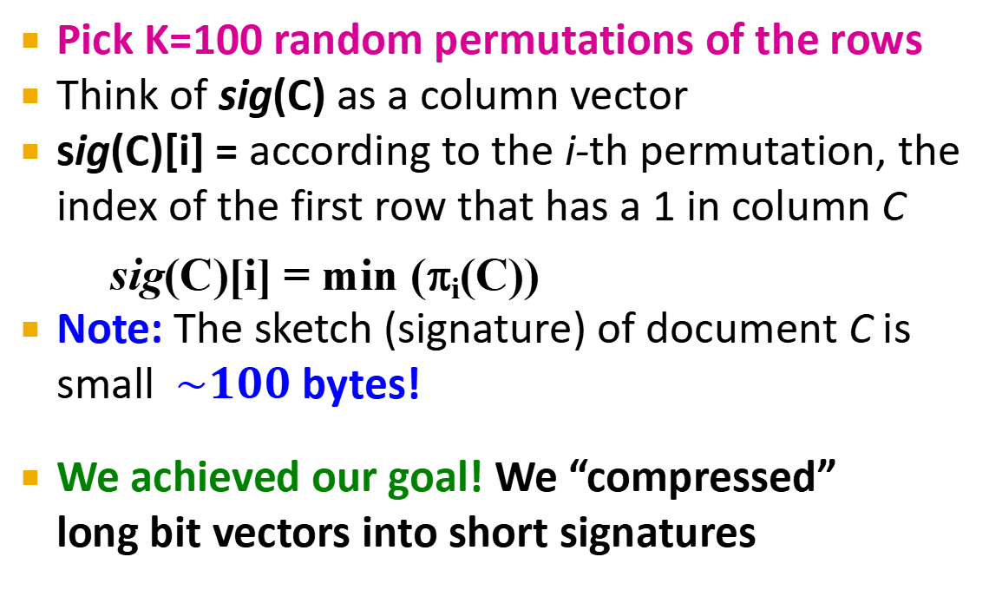
Min-Hash Signatures
Pick K=100 random permutations of the rows
Think of sig(C) as a column vector
sig(C)[i] = according to the i-th permutation, the index of the first row that has a 1 in column C
sig(C)[i] = min (π_{i}(C))
Note: The sketch (signature) of document C is small $\sim 100$ bytes!
We achieved our goal! We “compressed” long bit vectors into short signatures

Slide 33
Implementation Trick
Permuting rows even once is prohibitive
Row hashing!
Pick K = 100 hash functions k_{i}
Ordering under k_{i} gives a random row permutation!
One-pass implementation
For each column C and hash-func. k_{i} keep a “slot” for the min-hash value
Initialize all sig(C)[i] = ∞
Scan rows looking for 1s
Suppose row j has 1 in column C
Then for each k_{i} :
If k_{i}(j) < sig(C)[i], then sig(C)[i] ← k_{i}(j)
How to pick a random hash function h(x)?
Universal hashing:
h_{a,b}(x)=((a·x+b) mod p) mod N
where:
a,b … random integers
p … prime number (p > N)

Slide 34
Locality Sensitive Hashing
Candidate
pairs:
those pairs
of signatures
that we need
to test for
similarity
Shingling
Min-Hash-
ing
Locality-
Sensitive
Hashing
Docu-
ment
The set
of strings
of length k
that appear
in the doc-
ument
Signatures:
short integer
vectors that
represent the
sets, and
reflect their
similarity
Step 3: Locality-Sensitive Hashing: Focus on pairs of signatures likely to be from similar documents

Slide 35
LSH: First Cut
2
1
4
1
1
2
1
2
2
1
2
1
Goal: Find documents with Jaccard similarity at least s (for some similarity threshold, e.g., s=0.8)
LSH – General idea: Use a function f(x,y) that tells whether x and y is a candidate pair: a pair of elements whose similarity must be evaluated
For Min-Hash matrices:
Hash columns of signature matrix M to many buckets
Each pair of documents that hashes into the same bucket is a candidate pair

Slide 36
Candidates from Min-Hash
2
1
4
1
1
2
1
2
2
1
2
1
Pick a similarity threshold s (0 < s < 1)
Columns x and y of M are a candidate pair if their signatures agree on at least fraction s of their rows: M (i, x) = M (i, y) for at least frac. s values of i
We expect documents x and y to have the same (Jaccard) similarity as their signatures

Slide 37
LSH for Min-Hash
2
1
4
1
1
2
1
2
2
1
2
1
Big idea: Hash columns of signature matrix M several times
Arrange that (only) similar columns are likely to hash to the same bucket, with high probability
Candidate pairs are those that hash to the same bucket

Slide 38
Partition M into b Bands
2
1
4
1
1
2
1
2
2
1
2
1
r rows
per band
b bands
One
signature
Signature matrix M

Slide 39
Partition M into Bands
Divide matrix M into b bands of r rows
For each band, hash its portion of each column to a hash table with k buckets
Make k as large as possible
Candidate column pairs are those that hash to the same bucket for ≥ 1 band
Tune b and r to catch most similar pairs, but few non-similar pairs

Slide 40
Hashing Bands
Buckets
Columns 2 and 6
are probably identical
(candidate pair)
Columns 6 and 7 are
surely different.
Matrix M
r rows
b bands

Slide 41
Simplifying Assumption
There are enough buckets that columns are unlikely to hash to the same bucket unless they are identical in a particular band
Hereafter, we assume that “same bucket” means “identical in that band”
Assumption needed only to simplify analysis, not for correctness of algorithm

Slide 42
Example of Bands
2
1
4
1
1
2
1
2
2
1
2
1
Assume the following case:
Suppose 100,000 columns of M (100k docs)
Signatures of 100 integers (rows)
Therefore, signatures take 40Mb
Choose b = 20 bands of r = 5 integers/band
Goal: Find pairs of documents that are at least s = 0.8 similar

Slide 43
C₁, C₂ are 80% Similar
2
1
4
1
1
2
1
2
2
1
2
1
Find pairs of ≥ s=0.8 similarity, set b=20, r=5
Assume: sim(C₁, C₂) = 0.8
Since sim(C₁, C₂) ≥ s, we want C₁, C₂ to be a candidate pair: We want them to hash to at least 1 common bucket (at least one band is identical)
Probability C₁, C₂ identical in one particular band: (0.8)⁵ = 0.328
Probability C₁, C₂ are not similar in all of the 20 bands: (1-0.328)²⁰ = 0.00035
i.e., about 1/3000th of the 80%-similar column pairs are false negatives (we miss them)
We would find 99.965% pairs of truly similar documents

Slide 44
C₁, C₂ are 30% Similar
2
1
4
1
1
2
1
2
2
1
2
1
Find pairs of ≥ s=0.8 similarity, set b=20, r=5
Assume: sim(C₁, C₂) = 0.3
Since sim(C₁, C₂) < s we want C₁, C₂ to hash to NO common buckets (all bands should be different)
Probability C₁, C₂ identical in one particular band: (0.3)⁵ = 0.00243
Probability C₁, C₂ identical in at least 1 of 20 bands: 1 - (1 - 0.00243)²⁰ = 0.0474
In other words, approximately 4.74% pairs of docs with similarity 0.3% end up becoming candidate pairs
They are false positives since we will have to examine them (they are candidate pairs) but then it will turn out their similarity is below threshold s

Slide 45
LSH Involves a Tradeoff
2
1
4
1
1
2
1
2
2
1
2
1
Pick:
The number of Min-Hashes (rows of M)
The number of bands b, and
The number of rows r per band
to balance false positives/negatives
Example: If we had only 15 bands of 5 rows, the number of false positives would go down, but the number of false negatives would go up

Slide 46
Analysis of LSH – What We Want
Probability = 1 if t > s
Probability
of sharing
a bucket
No chance
if t < s
Similarity threshold s
Similarity t =sim(C₁, C₂) of two sets

Slide 47
What 1 Band of 1 Row Gives You
Probability
of sharing
a bucket
Remember:
Probability of
equal hash-values
= similarity
Similarity t =sim(C₁, C₂) of two sets

Slide 48
b bands, r rows/band
Columns C₁ and C₂ have similarity t
Pick any band (r rows)
Prob. that all rows in band equal = t^{r}
Prob. that some row in band unequal = 1 - t^{r}
Prob. that no band identical = (1 - t^{r})^{b}
Prob. that at least 1 band identical = 1 - (1 - t^{r})^{b}

Slide 49
What b Bands of r Rows Gives You
No bands
identical
At least
one band
identical
(
)^{b}
Probability
of sharing
a bucket
s ~ (1/b)^{1/r}
1 -
1 -
t ^{r}
All rows
of a band
are equal
Some row
of a band
unequal
Similarity t=sim(C₁, C₂) of two sets

Slide 50
Example: b = 20; r = 5
Similarity threshold s
Prob. that at least 1 band is identical:
s | 1-(1-s^{r})^{b}
.2 | .006
.3 | .047
.4 | .186
.5 | .470
.6 | .802
.7 | .975
.8 | .9996

Slide 51
Picking r and b: The S-curve
Picking r and b to get the best S-curve
50 hash-functions (r=5, b=10)
Prob. sharing a bucket
Blue area: False Negative rate
Green area: False Positive rate
Similarity

Slide 52
LSH Summary
Tune M, b, r to get almost all pairs with similar signatures, but eliminate most pairs that do not have similar signatures
Check in main memory that candidate pairs really do have similar signatures
Optional: In another pass through data, check that the remaining candidate pairs really represent similar documents

Slide 53
Summary: 3 Steps
Shingling: Convert documents to sets
We used hashing to assign each shingle an ID
Min-Hashing: Convert large sets to short signatures, while preserving similarity
We used similarity preserving hashing to generate signatures with property Pr[h_{π}(C₁) = h_{π}(C₂)] = sim(C₁, C₂)
We used hashing to get around generating random permutations
Locality-Sensitive Hashing: Focus on pairs of signatures likely to be from similar documents
We used hashing to find candidate pairs of similarity ≥ s

